Slide 1

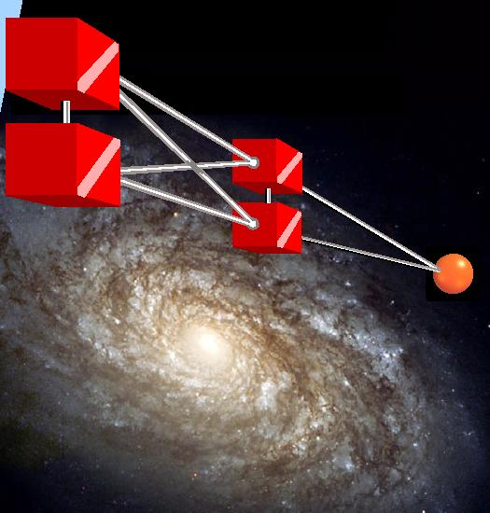
COMMON CHANNEL
SIGNALING SYSTEM #7

Slide 2

Presented By
MOHD AZAM
MCA,BCA
Email- mohd.azam.se@gmail.com

Slide 3
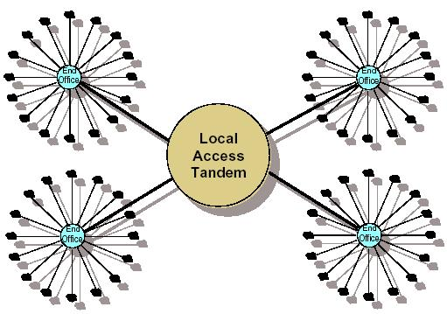
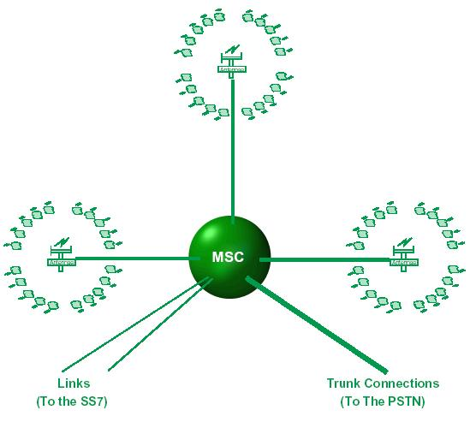
A CLOSE LOOK OF CCSS#7
PUBLIC SWITCHED TELEPHONE NETWORK ARCHITECTURE
WIRELESS NETWORK ARCHITECTURE

Slide 4
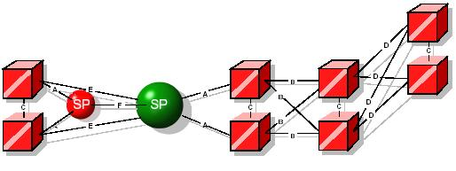
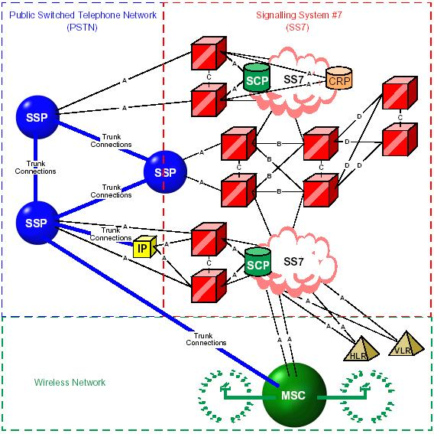
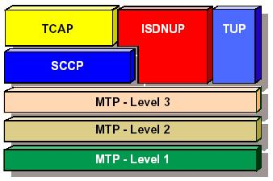
CCSS#7 NETWORK ARCHITECTURE
A LOOK OF COMLETE TELECOMM NETWORK ARCHITECTURE
LAYERED APPROACH OF CCSS#7

Slide 5
APPLICATIONS
STANDARD
ADVANTAGES
TOPICS WILL BE COVERED
DEFINITIONS & CONCEPTS
OBJECTIVES
HISTORY
3/5/2010
5

Slide 6
Some Basic Concepts to Understand the Common Channel Signaling System

Slide 7
SIGNALING
Signaling has always played a very important role in the field of communication, since it provide the means for the information interchange between two or more nodes within a network.
The way of performing signaling has evolved together with the evolution of the transmission equipment and of the used switching systems. Both of them were originally analog evolved into digital and now it is optical.
The term signaling, when used in telephony, refers to the exchange of control information associated with the establishment of a telephone call on a telecommunications circuit.

Slide 8
CLASSIFICATION OF SIGNALING
Topological Classification
Functional Classification
UNI Signaling System
Line Signaling
NNI Signaling System
Register Signaling

Slide 9
TOPOLOGICAL CLASSIFICATION
UNI (User to Network Interface) Signaling System
Switching communication between the calling subscriber and his own switching unit.
NNI Signaling System
A communication will also be required between each switching unit and the next one in the call sequence. This is the Network to Network Interface (NNI).
Channel Associated Signaling System (CAS).
Common Channel Signaling System #7 (CCS #7).

Slide 10
FUNCTIONAL CLASSIFICATION
At least two types of information will always have to be “signaled” between adjacent points:
Line Signaling = The intention to seize or to release a local line (in case of UNI signaling) or a trunk circuit (in case of NNI signaling).
Register Signaling = The call destination (under the form of dialed digits) will have to be passed from the register of the previous step to the register of the next exchange.

Slide 11
IN-BAND AND OUT-BAND SIGNALING
IN-BAND: In this signaling the control information and user information are send on a single line.
OUT-BAND: In this signaling the control information and user information are send separately into logically or physically separate paths.

Slide 12
SIGNALING MODES
The term “Signaling mode” refers to the association existing between the path taken a signaling message.
Associative Mode
In this mode, signaling points are directly connected by means of signaling links. In other words , direct link interconnecting the two points.
Non-Associative Mode
In this mode, two signaling points do not have to be directly connected by a signaling link. The signaling information can be sent via multiple STP’s (signaling transfer point). Since message can be routed indirectly, multiple paths become available between two signaling points.

Slide 13
Cont…
Cont…
Quasi Associative Mode
It is a limited case of the Non-Associative mode where the path taken by the message through the CCS #7 networks is the same for each message, pertaining to the same call. In this way a correctly sequenced delivery of all the information is guaranteed.
Because of these two reasons, CCS #7 is specified for use in the Associated and in the Quasi-Associated modes only.

Slide 14


What is the Common Channel Signaling System #7 (CCSS #7)?
CCS #7 is an advanced, digital signaling and control system, that is a set of telephony signaling protocols which are used to set up most of the world's telephone calls. With a high performance packet based communication protocols. standardized by ITU-TS (International telecommunication Union and Telecommunication standardization) in the 1980’s.

Slide 15
What about the naming, Common Channel Signaling System #7 (CCSS #7)?
It is usually abbreviated to SS#7 and also SS7, though in North America it is often referred to as CCSS#7, an acronym for "Common Channel Signaling System #7". In some European countries, specifically the United Kingdom, it is sometimes called C7 (CCITT number 7) and is also known as number 7 and CCIS7. (ITU-T was formally known as CCITT).

Slide 16
What are the features of Common Channel Signaling System #7 (CCSS #7)?
It is totally Out-Band.
It is message oriented.
It support the common channel.
It is easy to understand and implement because of it’s layered approach.
It is also very futuristic because any new feature or services can be added very easily.

Slide 17
HISTORY OF CCSS#7
Common channel signaling protocols have been developed by AT&T, BT and the ITU-T since 1975 and the first international Common Channel Signaling protocol was defined by the ITU-T as Signaling System #6 in 1977. Signaling System #7 was defined as an international standard by ITU-T in its 1980.
SS5 and earlier used In-Band signaling, where the call-setup information was sent by playing special multi-frequency tones into the telephone lines. This led to security problems.
SS6 and SS7 moved to a system in which the signaling information was out-band, carried in a separate signaling channel. This avoided the security problems.

Slide 18
COMING OF STANDARD
It was necessary to provide telecommunications standards that would create the compatibility necessary to provide end-to-end communications between international networks without regard to the nation of origin.
CCITT (Consultative Committee on International Telephone and Telegraph)
The task of establishing standards was undertaken by the International Telecommunications Union, which is a United Nations Treaty organization. The IT assembled a group known as the CCITT the result of their deliberations was Common Channel Interoffice Signaling System #6, first introduced in the 60s. Were there five previous versions? Of course. But only CCSS 6 survived to deployment.

Slide 19
Cont…
Recently, the CCITT group name has been changed to the Telecommunication Standardization Sector (TS) and groups responsible for radio communications (RS) have been added. The use of the term CCITT is rapidly being replaced by ITU-TS.
There is only one international SS7 protocol defined by ITU-T. There are however, many national variants of the SS7 protocols. Most national variants are based on two widely deployed national variants as standardized by ANSI and ETSI, which are in turn based on the international protocol defined by ITU-T. Each national variant has its own unique characteristics. Some national variants with rather striking characteristics are the China (PRC) and Japan (TTC) national variants.

Slide 20
OBJECTIVES AND APPLICATIONS
SS7, being a high-speed and high-performance packet-based communications protocol, can communicate significant amounts of information when setting up a call, during the call, and at the end of the call. This permits rich call-related services to be developed.
Some of the first such services were call management related services that we take for granted today:
Call forwarding (busy and no answer),
voice mail,
call waiting,
conference calling,

Slide 21
Cont…
called name and number display,
call screening,
malicious caller identification,
busy callback, etc.
calling name and number display,

Slide 22
ADVANTAGES
That is optimized for operational in digital telecommunications networks with stored programmed controlled exchanges.
CCS #7 is optimized for operation over 64 kb digital channels.
It is also suitable for operation over analog channels and at lower speeds.
It is suitable for point to point terrestrial on satellite links.
That can meet the present and future requirements for call control, remote control, and management and maintenance signaling.
Maintenance of small local exchange can be carried out remotely from a network service center.

Slide 23
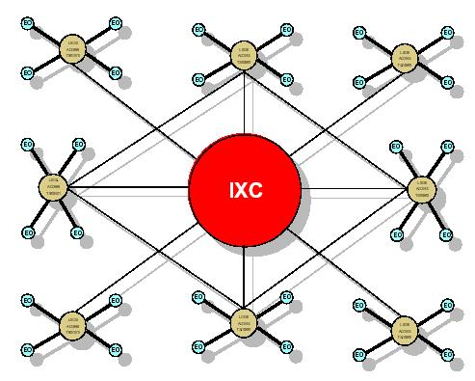
PSTN Network Architecture
Wireless Network Architecture
TOPICS WILL BE COVERED

Slide 24
PSTN ARCHITECTURE AND CONTEXT
The public switched telephone network (PSTN) is the network of the world's public circuit switched telephone networks, in much the same way that the Internet is the network of the world's public IP-based packet-switched networks. Originally a network of fixed-line analog telephone systems, the PSTN is now almost entirely digital, and now includes mobiles as well as fixed telephones.
The PSTN is largely governed by technical standards created by the ITU-T, and uses E.163/E.164 addresses (more commonly known as telephone numbers) for addressing

Slide 25
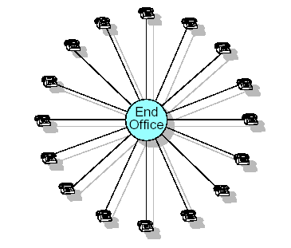
COMPONENTS OF THE PSTN
END OFFICES
A switch capable of making connections for the transmission lines that enter the building. For a local office most of these will be the lines that go to homes and offices and end at a telephone or, perhaps, at an office switchboard is called as a Local Exchange Office or simply known as End Offices.

Slide 26
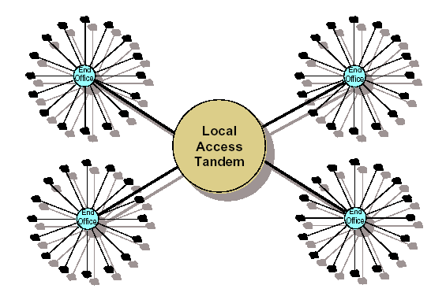
Cont…
LOCAL ACCESS TANDEM
A switch whose main purpose would be the interconnection of many local offices. The local switch, then, would not need a transmission line to every other local office. Instead, transmission lines going directly to the intermediate Switch would be sufficient.

Slide 27
Cont…
INTER EXCHANGE CARRIER
Taking our example one step further, the Tandem offices can be connected to another switch whose job is to connect switches. In this case the new switch would likely be a switch for long distance communication. Under previous FCC rules, this switch would be owned and maintained (or leased) by a long distance carrier or Interexchange Carrier (IXC).

Slide 28
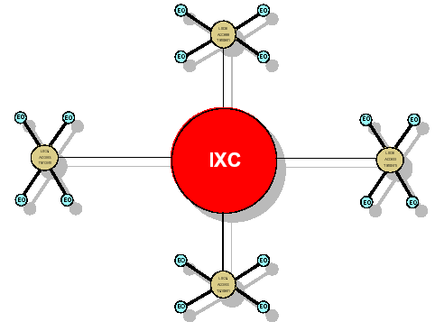
Cont…
INTER EXCHANGE CARRIER

Slide 29
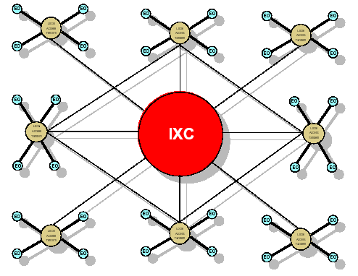
Cont…
A FINAL LOOK OF PSTN

Slide 30
WIRELESS NETWORK ARCHITECTURE AND CONTEXT
The truth is that the wireless network is truly “wireless” in only a small portion of its architecture. A mobile telephone transmits and receives to and from a transmitter/receiver. The transmitter/receiver is the first and last place in the network where the communications are wireless. The voice received from the mobile telephone must be connected into the PSTN. The voice received from the PSTN must end up connected to the transmitter for transmission to the telephone.

Slide 31
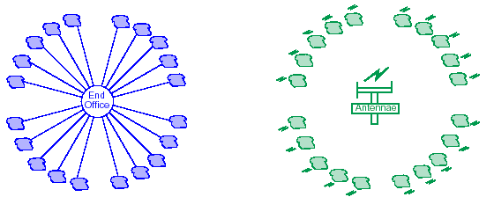
Cont…
The wireless company needs a switch to connect a call originating or terminating at their customer in the same way that the landline phone company needs an end office switch. An easy way to illustrate this is to show it side by side with an earlier drawing we used to illustrate the End Office part of the PSTN.

Slide 32
COMPONENTS OF THE WIRELESS NETWORK
MOBILE SWITCHING CENTRE (MSC)
The MSC needs “one foot” in the PSTN (Public Switched Telephone Network) and “one foot” in the SS7 (Signaling System #7) network. Landline connections must be made to connect the callers. Information pertaining to the call must be sent to the PSTN switches using the services of the SS7. The MSC then has requirements that PSTN switches do not have. Among these is the need to keep track of its subscribers. When the subscriber is within the range of any of the MSC’s transmitter/ receivers, the MSC receives an indication of the signal strength of the subscriber’s telephone at the location of the antennas.

Slide 33
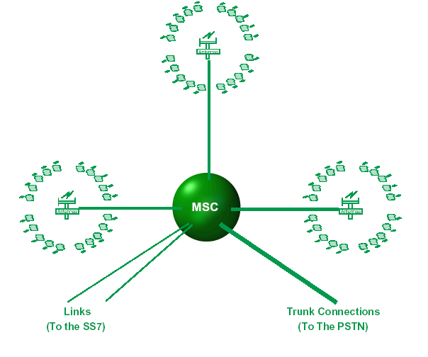
Cont…

Slide 34
Cont…
The MSC connects the antennae receiving the strongest signal. If the subscriber is “on the move” during the conversation, the signal will gradually weaken at one antennae while strengthening at another. The MSC is smart enough to know that transient conditions (such as passing under a Bridge) will have an effect on this balance.

Slide 35
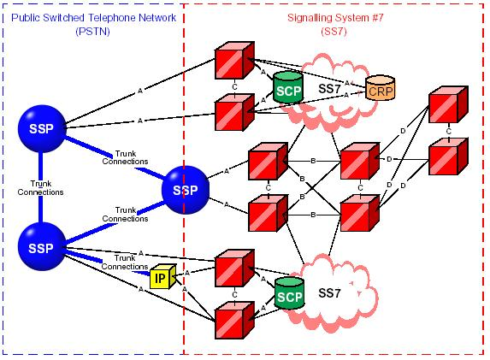
CCSS#7 NETWORK ARCHITECTURE
COMPLETE NETWORK
TOPICS WILL BE COVERED

Slide 36
CCSS #7 NETWORK
CCSS#7 clearly splits the signaling planes and voice circuits. An SS7 network has to be made up of SS7-capable equipment from end to end in order to provide its full functionality. The network is made up of several link types (A, B, C, D, E, and F) and three signaling nodes – Service Switching point (SSPs), Singling Transfer Point (STPs), and Service Control Point (SCPs). Each node is identified on the network by a number, a point code. Extended services are provided by a database interface at the SCP level using the SS7 network.

Slide 37

COMPONENTS OF THE SS7 NETWORK
STP (Signal Transfer Point)
The “knots” that hold the network together. These nodes serve to provide network access to other nodes (by connection with Access Links). STPs transfer messages around the network. STPs maintain routing tables for the purposes of directing messages to their intended destinations.

Slide 38
Cont…
SSP (Service Switching Point)
The Service Switching Point is a switch associated node which handles call set-up and has the ability to stop call processing, make queries of even unknown databases, and perform actions appropriate to the response. In general, the SS7 messages which originate or terminate here are either circuit or call routing related.

Slide 39
Cont…
SCP (Service Control Point)
In general, Service Control Points provide access to databases. These nodes are the residences of processes which can access the database, extract the required data and return it to the node requesting the data. The database(s) to which the SCP has access may or may not reside at the same location as the SCP. The same capabilities that allow the SCP to access databases lend themselves to other uses such as providing access to an IP.

Slide 40
Cont…
IP (Intelligent Peripheral)
The IP is the residence of processes which manage resources such as signaling sensors and voice response equipment. The resource management capabilities become available to switches on demand, thereby freeing switch locations from the need to equip with a myriad of such devices, and providing highly efficient use of both aging and up-to-date technologies.

Slide 41
Cont…
CRP (Customer Routing Point)
The CRP provides on-premises control of the routing information requested by switches for translation of 800 type dialing (not limited to 800 numbers). The operator of the CRP is a customer who requires rapid update and control of the translation of their own numbers.

Slide 42
Cont…
HLR/VLR (Home Location Register/Visitor Location Register)
A database that contains customer information about local subscribers is maintained by each provider. This is the Home Location Register. Another company will access this information when a “roamer” appears, and use the data for an entry into its Visitor Location Register.

Slide 43
Cont…
Network links
Links are simply the connections to establish the whole Network. The different types of links are as follows:
Access Links Link a node (Signaling Point) to a local STP pair.
Bridge Links Link two pairs at the same level (local/local, regional/regional).

Slide 44
Cont…
Cross Links Link two STPs together to form an STP pair.
Diagonal Links Link a local STP pair to a higher level STP pair.
Extended Links Link a node (Signaling Point) to a remote STP pair.
Fully Associated Links Link two associated nodes together

Slide 45
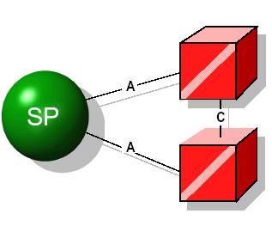
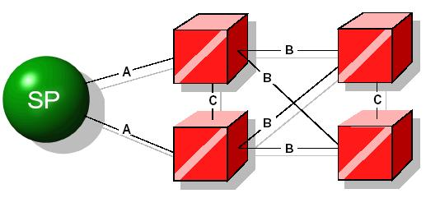
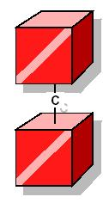
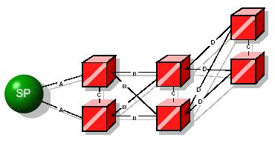
THE LINKS

Slide 46
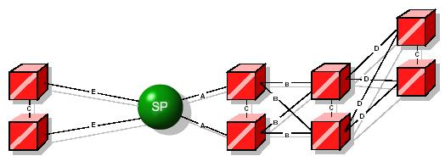
Cont…

Slide 47
Cont…

Slide 48
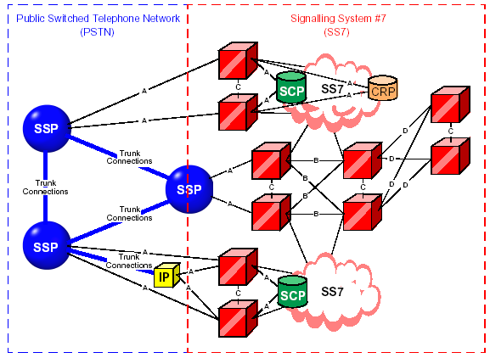
INTERCONNECTION AMONG SS7 COMPONENTS

Slide 49
A COMPLETE TELECOMMUNICATION NETWORK ARCHITECTURE

Slide 51
TCAP
TUP
ISDNUP
SCCP
MTP-LEVEL 3
MTP-LEVEL 2
MTP-LEVEL 1
TOPICS WILL BE COVERED

Slide 52
CCSS #7 AND OSI MODEL
The OSI model accepted by the ITU-T in 1980 offers a structured approach to the problem of data Communication. Since CCS #7 is in fact nothing more than a particular kind of data communication system (used for the signaling purposes), a very similar structuring with respect to the OSI model can be found.
This similarity is very high for the MTP part, though it becomes more difficult and inexact for the higher layers.

Slide 53
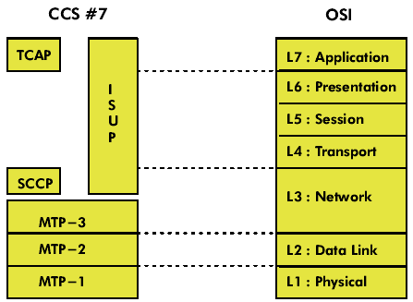
Cont…

Slide 54
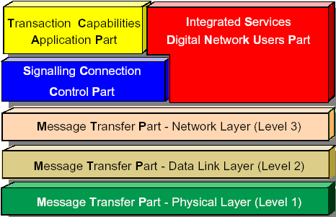
CCSS #7 LAYERS

Slide 55
Cont…
Layered Approach of CCS #7
In order to cope with the changing environment, a very flexible signaling system is required, which can perform signaling functions for all kinds of telecomm applications, already existing, or even future applications yet to be defined.
To provide this type of flexibility in CCS #7, a modular and layered structure is adopted. The functional principle of CCS #7 is the division of functions into a “Message Transfer Part”, that is also called “network services part” on one hand and separate “User Parts”, that is just an “application and functionality part” on the other hand.

Slide 56
CCSS #7 LAYERS DISTRIBUTION
  Network Service Part
    MTP-Level 1
    MTP-Level 2
    MTP-Level 3
    SCCP
  2) User Part
    TCAP
    ISDNUP adapted for PSTN calls was adopted in North America to process Plain Old Telephone System (POTS) calls.
    TUP The was adopted in Europe.

Slide 57
MTP-LEVEL 1 (PHYSICAL LAYER)
MTP1 represents the physical layer. This is, the layer that is responsible for the connection of SS7 Signaling Points into the transmission network over which they communicate with each other. Primarily, this involves the conversion of messaging into electrical signal and the maintenance of the physical links through which these pass.
That means it deals with physical issues at the level of links, interface cards, multiplexers etc.

Slide 58
Cont…
A signaling data link has the following features:
  A mechanical interface: A connector providing physical access to the outside world.
  An electrical interface: the set of electrical signals required to send digital data.
  A functional interface: a set of extra functions, supplementary to data transport itself.

Slide 59
MTP-LEVEL 2 (DATA LINK LAYER)
This is a busy MTP part. It monitors the links and reports on their status. It checks messages to ensure their integrity (both incoming and outgoing). It discards bad messages and requests copies of discarded messages. It tests links before allowing their use. MTP2 provides error detection and sequence checking, and retransmits unacknowledged messages. MTP2 uses packets called signal units to transmit SS7 messages.
While MTP-1 will transmit the messages from exchange to exchange. MTP-2 provides reliable transfer of signaling messages between 2 directly connected SP’s. it makes sure that the message is free of errors and that no information will lost during transmission.

Slide 60
Cont…
FUNCTIONS OF MTP2:
Signal Unit Delimitation
  The beginning and the end of signal unit are indicated by a unique 8 bit code, called as bit stuff.
Signal Unit Alignment
loss of alignment occurs when a bit pattern disallowed by the delimitation.
Signal Unit Error Detection
  it is done by means of 16 check bits provided at the end of each of SU.
Signal Unit Error Correction
  There are two methods of error correction. The method used depends on whether the transmission is land based or satellite based.

Slide 61
Cont…
  Signal Unit Error Monitoring
  It provides two types of monitoring the Alignment Error Rate Monitor (AERM) and Signal Unit Error Rate Monitor (SUERM).
  Flow Control
Flow control allows traffic to be throttled when level 2 becomes congested. The congested receiving end notifies the remote transmitting end by an appropriate signal unit and it also withholds acknowledgement of all incoming signal units.

Slide 62
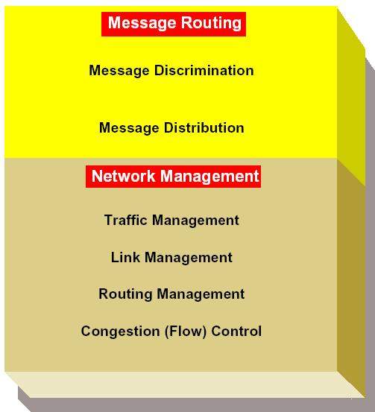
MTP-LEVEL 3 (NETWORK LAYER)
The functions of level 3 are divided into two major categories. One of these is Message Routing (or Signaling Message Handling). The other is Signaling Network Management. Network Management can be further broken down into four sub-categories.

Slide 63
Cont…
Signaling Message routing functions :
These functions ensure that the signaling message originated by a particular User part are delivered to the same User part at the destination signaling point.
Message Discrimination: In this type of functionality, it answers the question “Is this message is intended for this SP?” if yes then go for distribution.
Message Distribution: In this type of functionality, it answers the question “For which user part is it intended?”.
All messages handed off to level 3 (by either a higher or lower level) are either en route to the application via level 4 user parts (SCCP, ISDNUP, TUP, etc.) or they are en route to the adjacent node via level 2 and the SS7 signalling links.

Slide 64
Cont…
Signaling Network Management functions :
These functions provide reconfiguration of the signaling network in the case of failures and to control traffic in case of congestion. They can also activate and align new signaling links.
The functions are as :
    Traffic Management
    Route Management
    Link Management
    Congestion (Flow) Control

Slide 65
THE SCCP
The Signaling Connection Control POINT (SCCP) is a network layer protocol that provides extended routing, flow control, segmentation, connection oriented, and error correction facilities in SS7 telecommunications networks. SCCP relies on the services of MTP for basic routing and error detection. The standards were written for the SCCP to support both connection oriented and connectionless services. The term “connection oriented” refers to a “virtual” connection rather than a physical one. Now we can concentrate on the actual uses of SCCP. The services offered by the SCCP are shown as :
SCCP Service Types
  Connectionless
  Connection Oriented

Slide 66
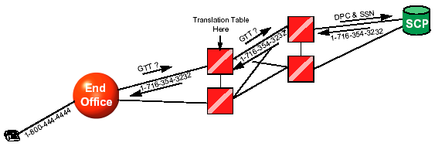
Cont…
Extended Functions
  Specialized Routing Functions : e.g. GTT(Global Title Translation) with DPC (Destination Point Code), allow the locating of database information or the invoking of features at a switch.
  Subsystem Management: It deals with the databases to provide the required information by the queries, e.g. Traffic handling

Slide 67
THE TCAP
The Transaction Capabilities Application Part offers its services to user designed applications as well as to OMAP (Operations, Maintenance and Administration Part). TCAP is used largely by switching locations to obtain data from databases (SSP from 800 Db, MSC from HLR, etc.), or to Invoke features at another switch (like Automatic Callback or Automatic Recall). It also provide the supports for roaming conditions using HLR(Home Location Register) and VLR(Visitor Location Register).
Remember that TCAP uses the services of the SCCP which in turn uses the services of the MTP.

Slide 68
ISDN USER PART (ISUP)
ISUP is used throughout the PSTN to provide the messaging necessary for the setup and teardown of all circuits, both voice and digital. Wireless networks also make use of ISUP to establish the necessary switch connections into the PSTN. ISUP messages are sent from each switch to the switch where the next circuit connection is required.
ISUP offers two types of services, known as Basic and Supplementary. Basic Services consist of those services employed in the process of setting up and tearing down a call. Supplementary Services consist of those services employed in passing all messages that may be necessary to maintain and/or modify the call.

Slide 69
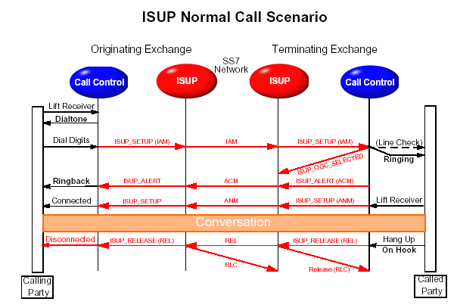
Cont…

Slide 70
TELEPHONE USER PART (TUP)
It is a part formerly employed largely in Europe to help implement switch connections. It is called the Telephone Users Part (TUP), and it has been used in Europe in ways resembling the use of the Integrated Services Digital Network in the U.S. Nevertheless, the use of ISDNUP (or at least the circuit control functionalities commonly called ISUP) is replacing TUP worldwide. Some holdouts (such as China) still use TUP. The Telephone User Part supports the setup and release of telephone calls.

Slide 71
BIBLIOGRAPHY
TEXT
Common channel signaling System.
Simply SS7.
References
Dryburgh, Lee; Jeff Hewitt (2004). Signaling System No. 7 (SS7/C7): Protocol, Architecture, and Services. Indianapolis: Cisco Press.
Ronayne, John P. (1986). "The Digital Network", Introduction to Digital Communications Switching
Russell, Travis (2002). Signaling System #7, 4th Edition, New York: McGraw-Hill.
Link
www.protocol.com

Slide 72
THANK YOU
3/5/2010
72
Notes:
72

